Slide 1
JEE - JSP

Slide 2
Servlet-Limitations
Generating Dynamic HTML Response
Developer and Designer work together.
Changes with Presentation code is difficult
Controlling + B.L + Presentation code together
If any changes with servlet, need to re-compile, re-built, re-deploy entire project

Slide 3
Solution
Use JSP with Servlet.
What JSP Will do?
It Will separate Presentation Logic from Servlet

Slide 4
No ‘HTML Response’ → Servlet
Dynamic HTML Response → JSP
Static HTML Response → HTML

Slide 5
HTML → pure HTML tags with CSS and JavaScript.
Servlet → pure Java Code with HTML
JSP → HTML Tags + Java Code + CSS + JavaScript + Custom Tags.

Slide 6
JSP
JSP is HTML Document having java operation code, will produce dynamic HTML Response.

Slide 7
JSP
In the end, a JSP is just a servlet.
The Container will translate JSP file into servlet at runtime.

Slide 8
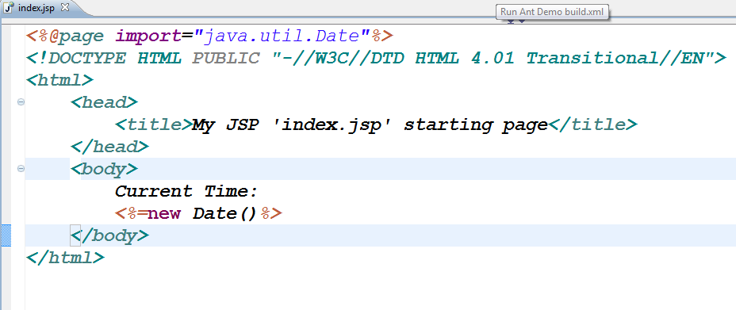

Slide 9
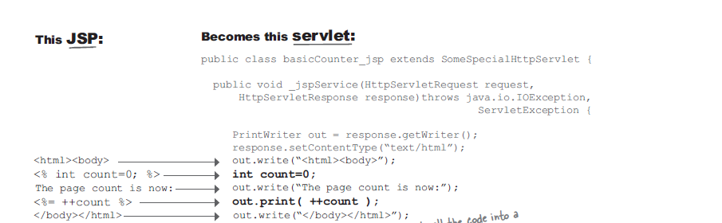
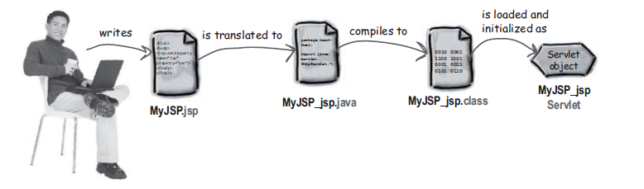
JSP – Life Cycle

Slide 10
JSP Topics
Implicit Objects
Scripting Elements
Directives
Action Tags
Expression Language ( EL)
JSTL
JSP Custom Tags

Slide 11
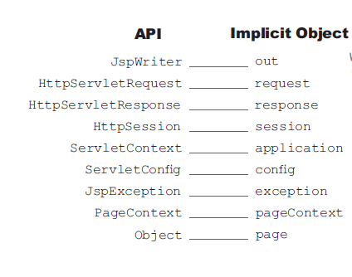
JSP-Implicit Objects

Slide 12
Scripting Elements
To Insert Java Code on the JSP Document to make dynamic Page.
Without Scripting Elements container cannot differentiate ‘Java Code’ from HTML Tags.

Slide 13
Types – Scripting Elements
Script let
Assignment/Expression
Declaration
Comment
Directive

Slide 14
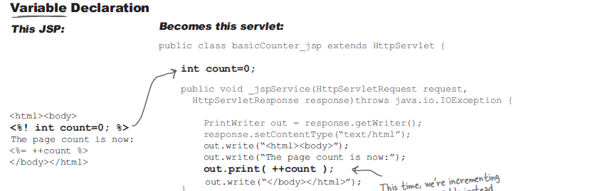
Declaration

Slide 15
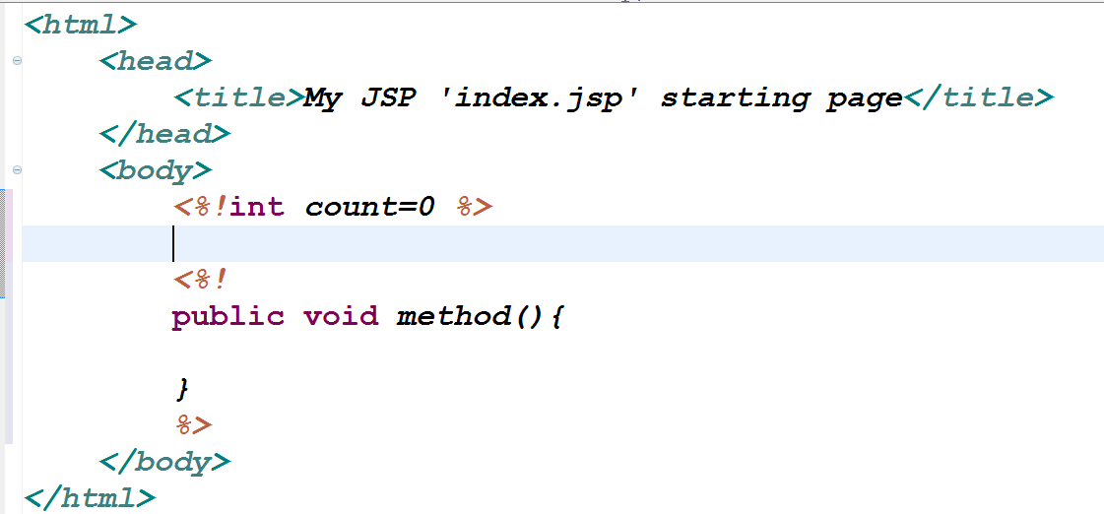

Slide 16
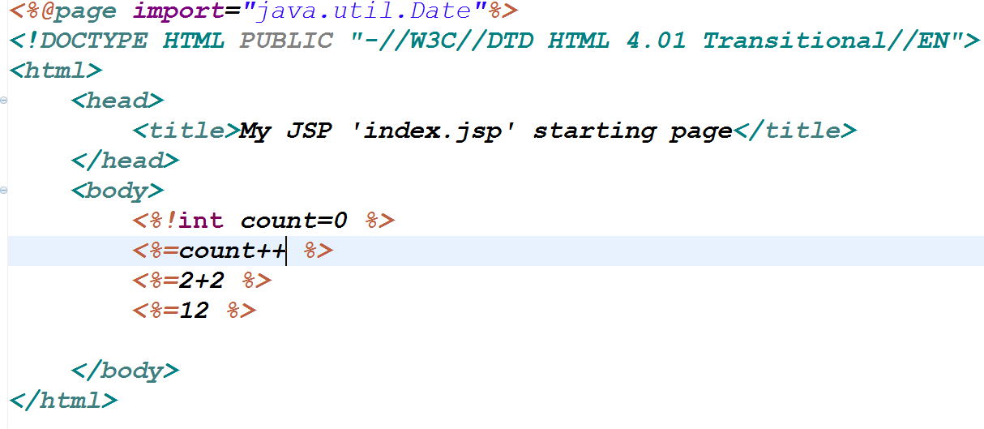
Assignment/Expression

Slide 17
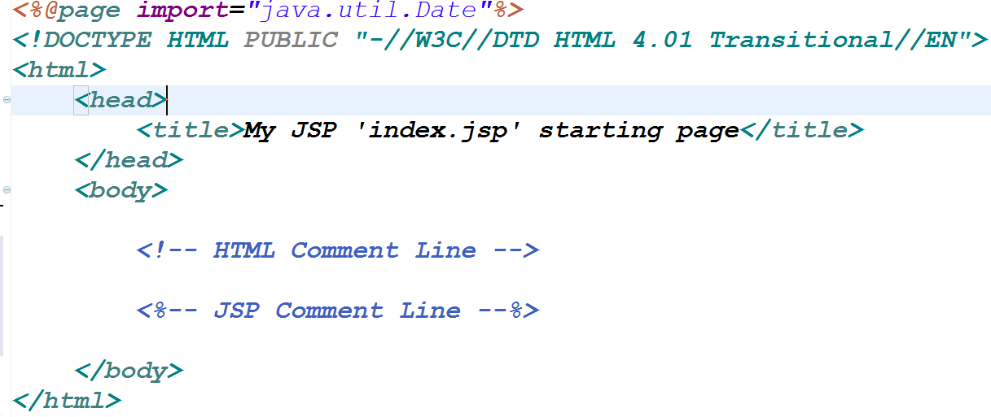
Comment

Slide 18
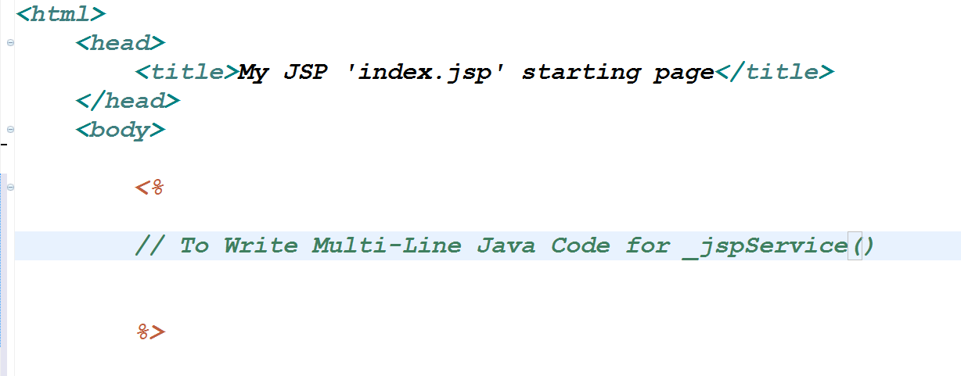
Script let

Slide 19
Directive
To give direction to Web Container, how to translate .jsp to Servlet.
3 types
Page
Include
taglib

Slide 20
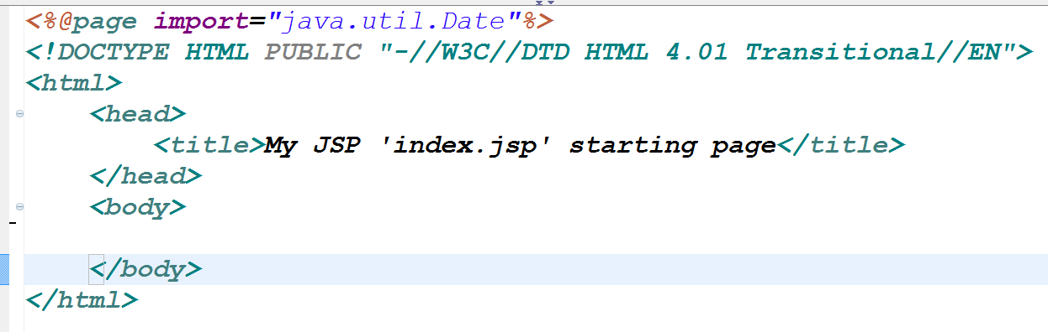

Slide 21
JSP Directives
3 types
Page
To provide page level properties
Include
To include any static file to JSP at translation time.
Taglib
To use Custom tag library to JSP page.

Slide 22
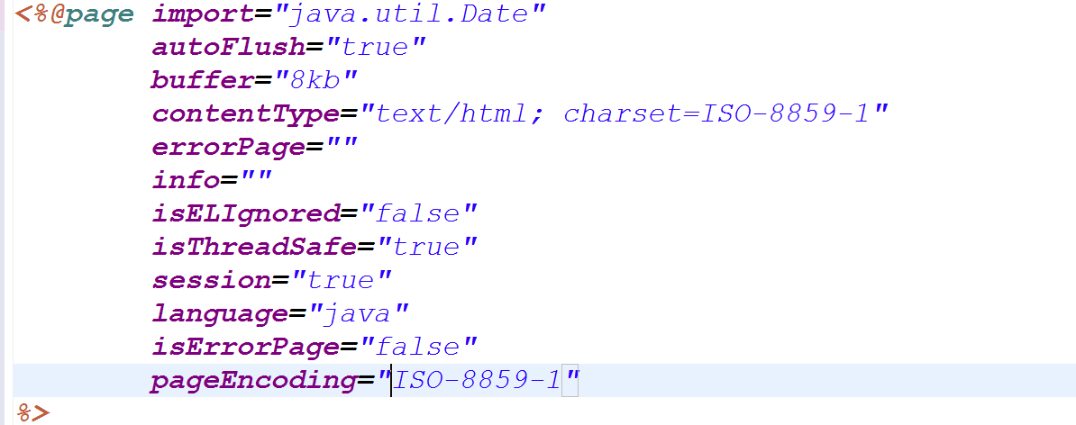
Directive - Page

Slide 23
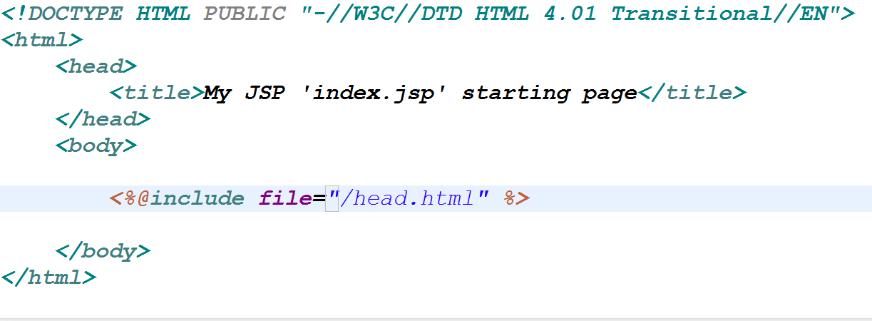
Directive - Include

Slide 24
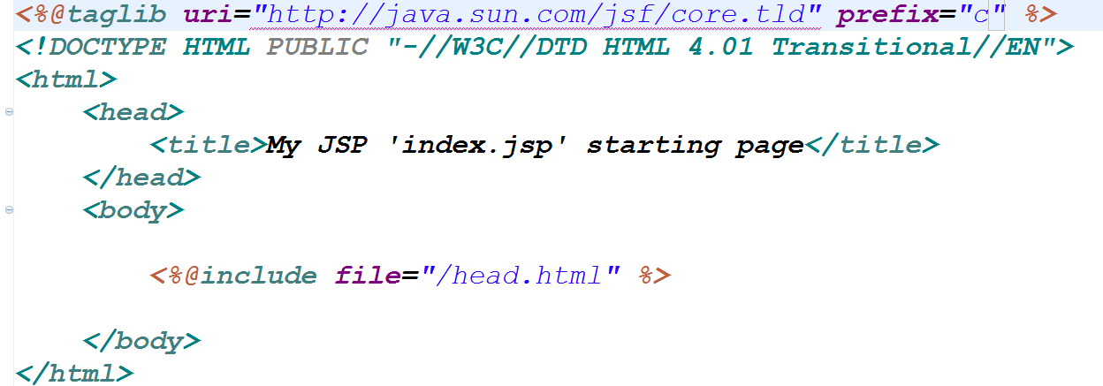
Directive- taglib

Slide 25
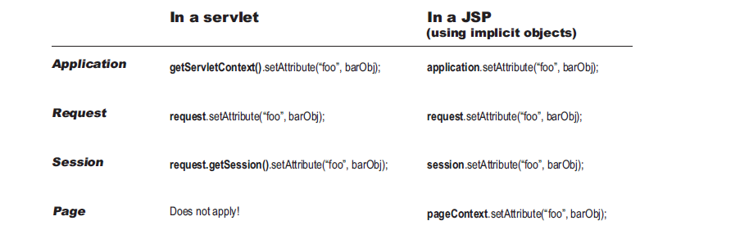
JSP-Attributes

Slide 26
MVC Example
Any MVC Example.

Slide 27
Old JSP
More Script lets on JSP page makes page complex.
Java Code and HTML Code Mixing makes page complex.
Any changes with page presentation code will becomes difficult.
JSP page becomes very hard to debug.

Slide 28
New JSP
Minimize using more scripting Elements
Use Action Tags
Use Expression Language ( EL )
Use JSTL tags
Use JSP Custom Tags.

Slide 29
Action Tags
Tags will do action(dynamic operation) on JSP page.
Very simple to use them.
Perform all standard operations on JSP without much scripting Elements.

Slide 30
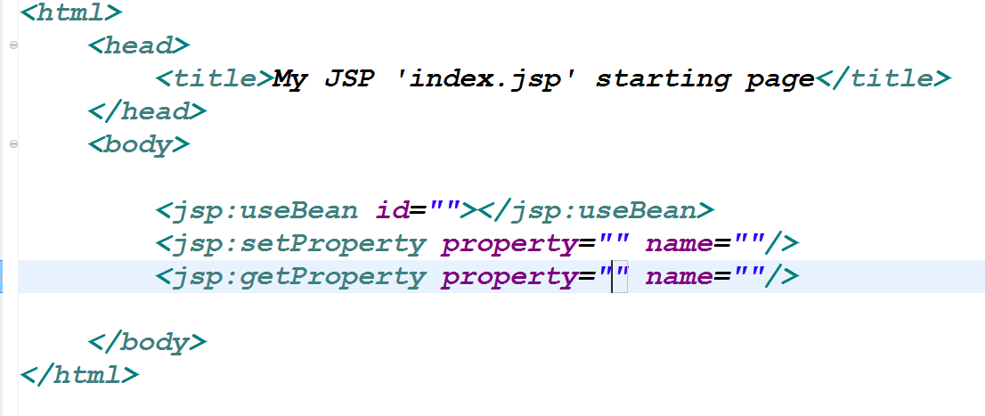
Action Tags

Slide 31
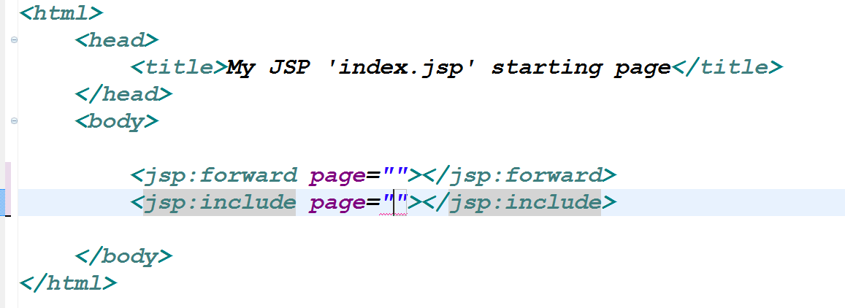
Action Tags

Slide 32
EL
Expression Language ( EL )
----------------------------
To Make JSP Page is Simple.
Added with JSP2.0 spec
One Line Code.

Slide 33
EL- What we can do
To Perform A/L/R and assignment operations.
To Read Request Params to JSP
To Read any scope Objects(Attributes) to JSP
To Read Init Params TO JSP
To Read Request Cookies to JSP
To Get Request Header Info To JSP
To Read Java Bean Object, MAP , List , Array to JSP from any scope.

Slide 34
EL-Adv
--> One Line Code
--> Even designer can understand. because its not Java Code.
--> We can easily embed with HTML Code.

Slide 35
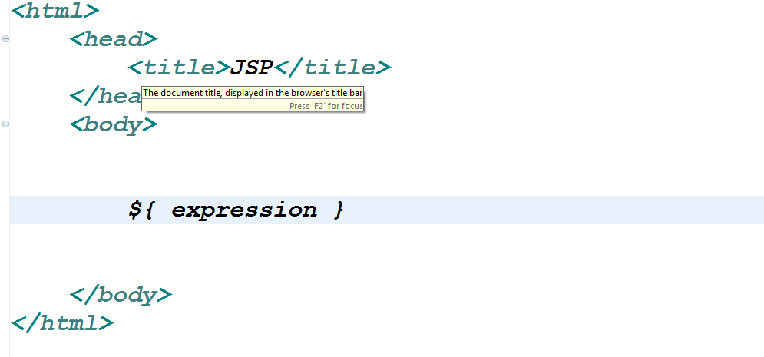
EL-Syntax

Slide 36
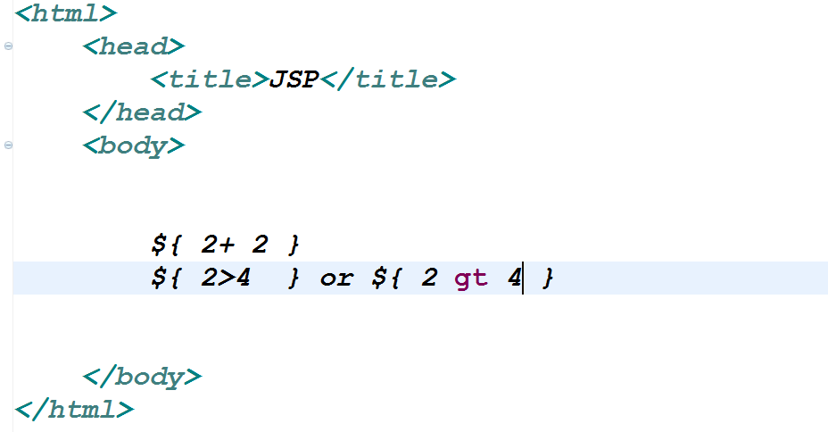
EL-Syntax : Way 1

Slide 37
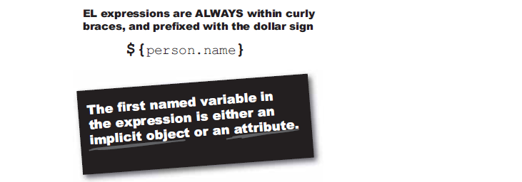

Slide 38

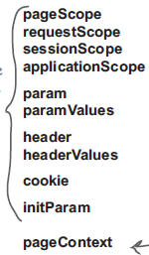
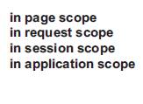

EL Syntax: Way 2

Slide 39
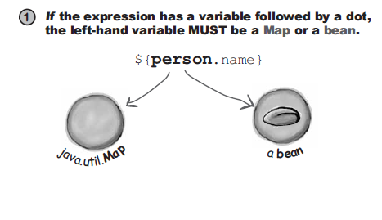
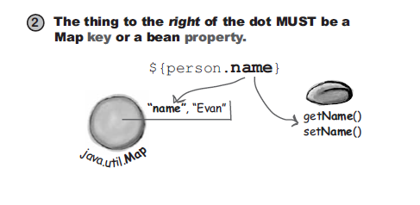
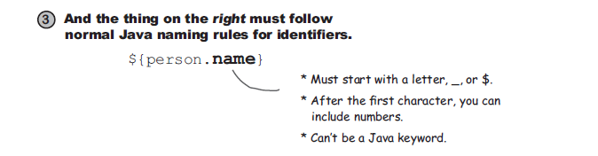
EL Syntax

Slide 40

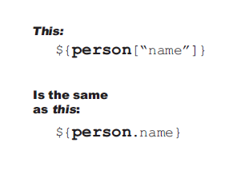
EL- Syntax: Way 3

Slide 41
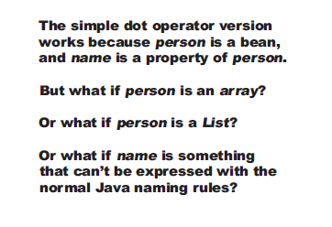

Slide 42

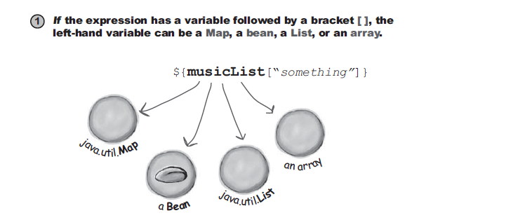

Slide 43
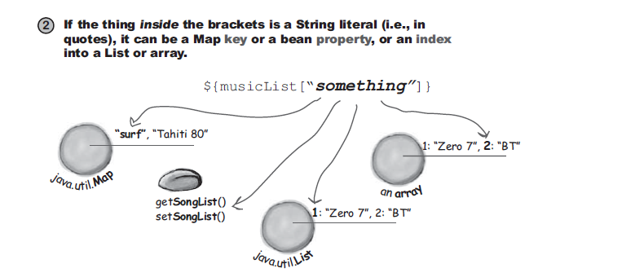

Slide 44
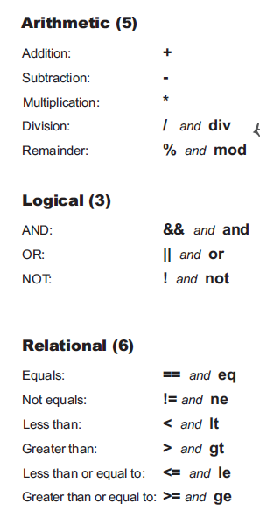
EL

Slide 45
JSTL
JSTL ( JSP Standard Tag Library )
-------------------------------------------
JSP Custom Tags given by Apache, to perform standard operations on JSP Page, without Java Code.
To Keep JSP Page script(javacode) free

Slide 46
JSTL
How to configure JSTL with JSP?
---------------------------------------------
--> download 2 jar files from apache site
1. jstl.jar
2. standard.jar
--> place 2 jars in /WEB-INF/lib folder.

Slide 47
JSTL
JSTL Tag libraries
-----------------------
1. core
2. sql
3. xml
4. functions
5. formatting

Slide 48
adv of Custom Tags:
-------------------
To Separate processing Logic from HTML Code.

